Slide 1
time-series-19-covid-combined
File created on: 02-04-2020 12:51:56

Slide 2
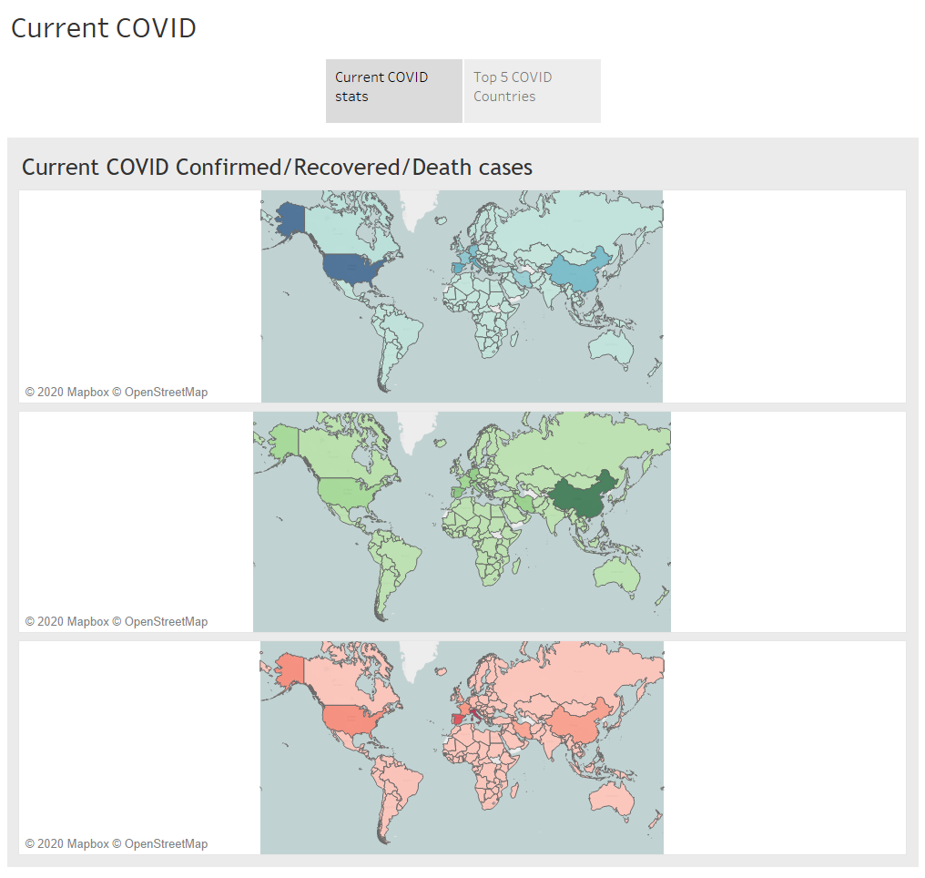

Slide 3
